Slide 1
Perspectives on Modifications and Alterations on Modern Composite Airplanes
Paul Brey
July 20, 2016
FAA Workshop on Modifications and Alterations Affecting Composite Parts or Composite Structures

Slide 2
Starting Point
AC43-214, Repairs and Alterations to Composite and Bonded Aircraft Structure
Key: The standard for alterations and modifications is exactly the same as for initial type certification
Notes:
This is difficult for new entrants and inexperienced modifiers to understand.
Many want to commercialize modifications the same way they would do for themselves.

Slide 3
Required Data for FAA Approval or Acceptance
Per AC43-214
Drawings
Substantiation Data
Material Specifications
Fabrication and Process Specifications
Inspection Procedures
Defect Accept/Reject Criteria
Nothing new here.

Slide 4
Comparison to Conventional Metal Structure
Conventional metal structure has a deep body of knowledge and experience to guide engineering design and substantiation of most design changes
Composites are less clear

Slide 5
Metal Structures
AC 43.13-2 guidance
Evolution of fail safe, fatigue, damage tolerant design, and finally, understanding the combination of these results in current regulation
Regulations end up requiring test based evidence to address damage tolerance and wide spread fatigue damage

Slide 6
Metal Structures
How can non-DAH entities address need for test?
AFS-300 Major Repair/Alteration Data Approval Job Guide provides experience based guidance!

Slide 7
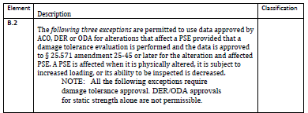
Metal Structures

Slide 8
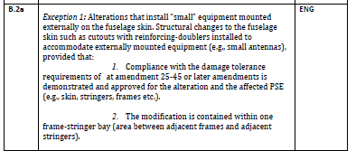
Metal Structures

Slide 10
Metal Structures

Slide 11
Metal Structures
Accepted and proven methods and material properties
MMPDS
NASGRO SW
AFGROW SW
Robust FEA
Simple isotropic materials with recognized spec basis
Conventional, time proven design configurations
Well established NDI methods

Slide 12
What Do We Have For Composite Structures?
It took more than a half century to develop experience, guidance, and methods to manage fabric, wood, and aluminum structures
Few composite materials are stable in production for more than a decade
Material producers are continuously improving mechanical performance or processing ease/cost
OEMs and new entrants constantly seek advantage

Slide 13
Composite Structures
How will industry and regulatory entities monitor aging performance?
How will we “normalize” this information to allow combining information to generalize conclusions about materials and configurations?

Slide 14
Alterations and Modifications – Why?
Changes, Alterations, and Modifications a natural part of the life and safety improvement progression of a new system entering operations!

Slide 15
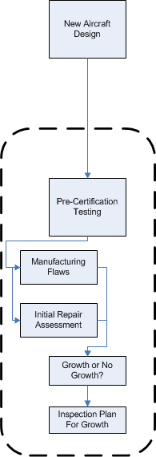
Life Cycle Progression for a New System

Slide 16
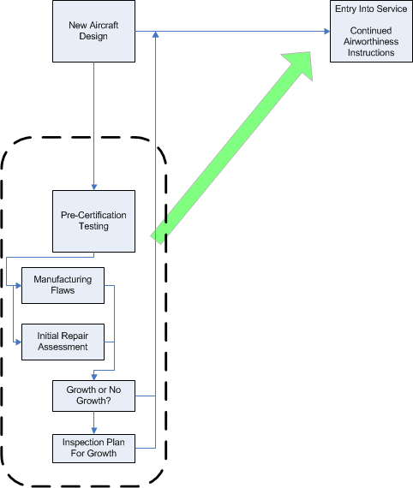
Life Cycle Progression for a New System

Slide 17
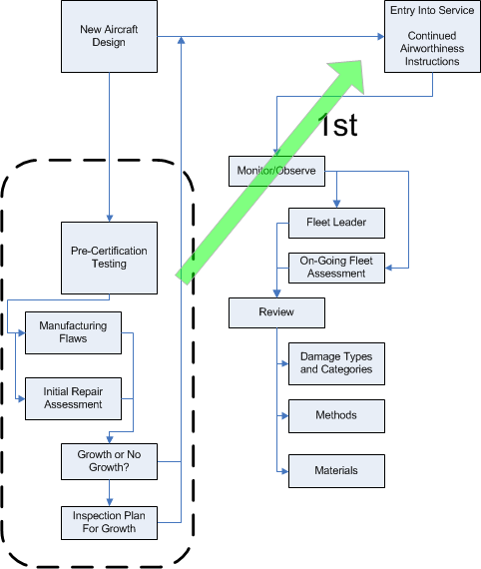
Life Cycle Progression for a New System

Slide 18
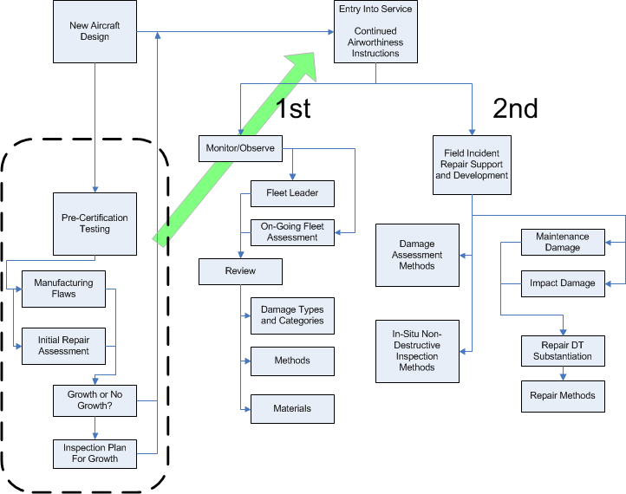
Life Cycle Progression for a New System

Slide 19
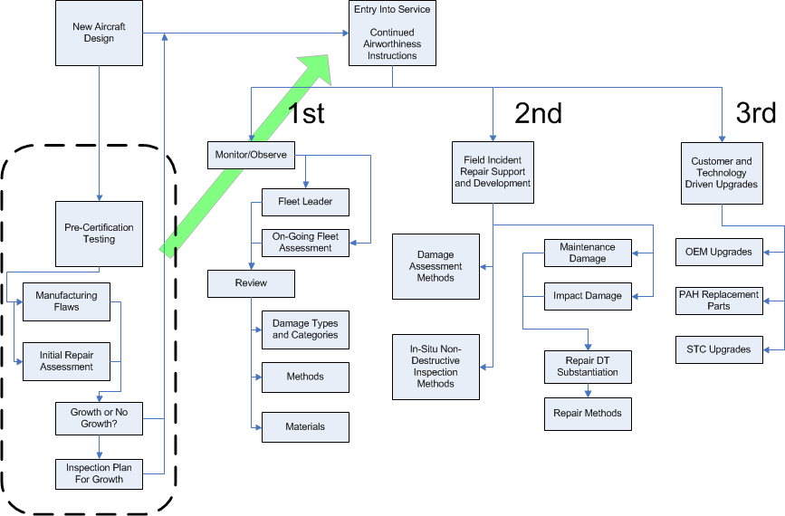
Life Cycle Progression for a New System

Slide 20
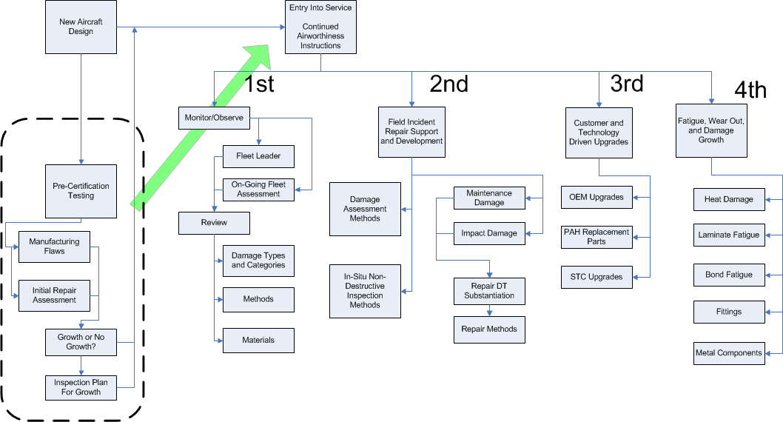
Life Cycle Progression for a New System

Slide 21
Alterations and Modifications - Why
Aging Systems will always need improvements to compete with newer systems
Operational economics drives this need

Slide 22
What Should We Expect?
Correction or enhancement to address initial design shortfalls
Performance Enhancement
Re-engine
Drag Reduction
Fuel Quantity Increase
Weight Growth

Slide 23
What Should We Expect?
Systems and Safety Upgrades
Avionics and Flight Controls improvements
Instruments/Displays
Sensors
Autopilot/Servos
Autoland/Autonomous Flight
Comm and Operational Environment
ADS-B
RVSM
Next Next Gen?
These will be the most common changes in the future: Antennas and new equipment installations

Slide 24
What Should We Expect?
Systems and Safety Upgrades
Known Ice capability
Condition Monitoring
Condition Monitoring may offer the greatest long term safety benefit to manage systems and structures

Slide 25
What Should We Expect?
Passenger Amenities
Environmental Comfort
Interiors
Passenger Communication Systems/Internet
We should be expecting a sudden proliferation of modifications to add high band width internet

Slide 26
DAH vs Other Engineering Entity
We have to accept that the DAH has the advantage
Material data
Configuration data
Loads
Validated models
Test data
Knowledge of margins
DAH generally wants to keep this advantage

Slide 27
DAH vs Other Engineering Entity
Other Engineering Entities still need to meet the same standard
More work!
More investment!
Or, smart partnering arrangements…
There is no substitute for a real, marketable alteration with a viable business plan
As an engineering service provider, you should confirm this before taking projects
Notes:
There really is no substitute for a real, marketable alteration with a viable business plan.
Too bad the FAA can’t reject projects with little or no value

Slide 28
Designing Alterations
Purpose of Alteration
Clearly describe the intent and impact of the modification
Why are you doing the modification?
What flight and ground conditions are affected?
How is aircraft performance affected?
What systems are affected?
What load paths are affected?
What are the critical environmental considerations?
Conduct a thorough FMEA

Slide 29
Designing Alterations
Major vs Minor
This is a crucial determination
Policy guidance on Substantiation of Secondary Composite Structures, PS-ACE100-2004-10300 is very helpful
Introducing new materials into an airframe will still need specification and test support
Test for credit means “major” or STC, coordinate certification plans early

Slide 30
Designing Alterations
Material Considerations and Selection
Foundation for the design
Assess structural and system impact for selected material
Available Data:
With few exceptions, supplier data is of little value
What else is out there?
DAH AMM/SRM information
ARP information
CMH17/AGATE
Development of proprietary data

Slide 31
Designing Alterations
Material Considerations and Selection
How much testing at the material level?
Select materials with existing allowable if possible!

Slide 32
Designing Alterations
What is the strategy for ensuring part and installation integrity?
Substantiate and control materials and process for repeated application
Or
Substantiate individual fabrication and installation instances
This selection determines the level of conservatism of the analytical and test substantiation

Slide 33
Designing Alterations
Substantiate and control materials and process for repeated application
Material and process spec required
Allowables or equivalency per guidance
Select properties important to specific details of design
Include properties that will need RI inspection and that the material supplier can provide
Include bond and co-bond allowables for lap joints and design detail specific joints

Slide 34
Designing Alterations
Substantiate individual fabrication and installation instances
Allowables or equivalency testing per existing guidance to assess local variability
Selection of instance based witness coupon testing for critical properties in substantiation
Test procedures and commercial arrangement for instance based testing
Use of very conservative allowables to reduce risk of failure of witness coupons
Substantiation analysis and/or testing of substandard instance of installation or component

Slide 35
Design and Substantiation
Reference AC20-107
Loads
DAH sources
Estimation
Local testing and reverse engineering
Static strength – conventional and FEA techniques tailored to allowables

Slide 36
Design and Substantiation
Plan for Continued Airworthiness
This is the backbone for safe continued operation!
Robust field inspection plan is the best insurance for continued airworthiness
Probability of Detection matters – it should be proven for the defects that will be allowed
Selection of allowed defects determine both static and DT substantiation rigor

Slide 37
Design and Substantiation
Damage Tolerance
My experience is based in testing with defects
In most cases, element level testing can be sufficient for component and relatively small modifications
In well analyzed structure, there is usually one or several critical details that drive or bound overall performance
Larger modification may need full scale test
What is the state of art for analytical substantiation?

Slide 38
Inspection
Development of appropriate inspection method and standard to bound lower level of acceptance
At the part or component fabrication level, and the installation

Slide 39
Evolution of Policy - Comments
Composite airframes, as we know them today, will be more costly to develop and substantiate alterations for non-DAH’s than metal structures – this needs to be communicated to less inexperienced applicants
It would seem that use of composites will generally reduce or eliminate the economic advantage of modification as a means to move aircraft from one intended operational use to another alternate use such as freight or air ambulance, as has been practice with metal airplanes

Slide 40
Evolution of Policy - Comments
This is counter to the likely outcome that composite airplanes may have very long extended life durability compared to metal construction

Slide 41
Evolution of Policy - Comments
We don’t know the aging response to composite aircraft construction yet
Conservative design criteria have generally resulted in no-growth DT designs; so we don’t really know the damage tolerance, life, or fatigue wear out margins we are dealing with
Initial indications tell us conservative design criteria result in little or no structural decay, at least not in any measurable or conclusively inspectable way
Bond joint, bolt joints, and metal fittings will likely be the culprit.
For sure, as substantiated life is approached, there will be demand by owner/operator to extend them

Slide 42
Evolution of Policy - Comments
As an industry, we need to develop new bodies of knowledge and new approaches to developing alterations

Slide 43
Questions I Have
Are non-DAH alterations really needed to continue proliferation of system and operational safety improvement?
What is the role of structural health and condition monitoring in the future?
Can operational oversight compensate for less long term experience with an equivalent level of safety?
Can we develop an infrastructure to support “instance based” material and process verification?
Notes:
It will take a lot of resources to develop non-DAH methods and data

Slide 44
Thank You For Listening!
Question?

